Slide 1
Verbal and Nonverbal Communication
Definition, Features, Examples

Slide 2
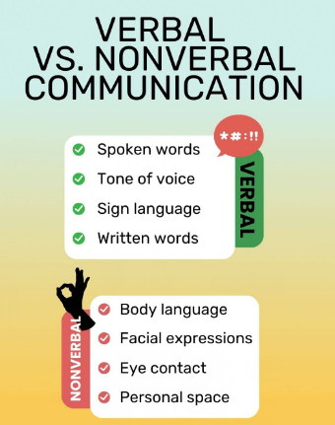

Slide 3
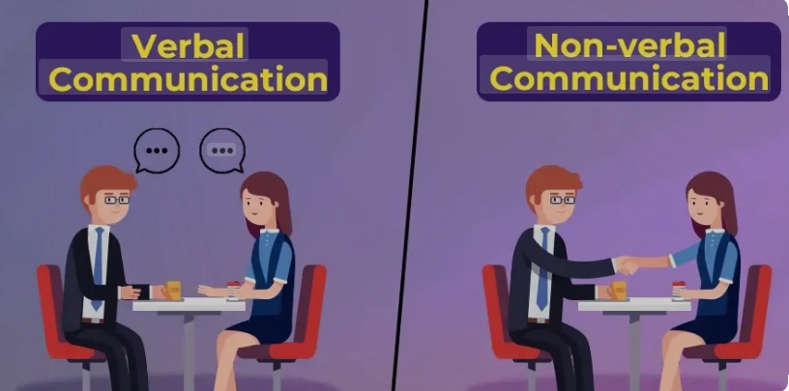

Slide 4
Verbal communication uses spoken or written words to exchange messages, while nonverbal communication relies on actions, expressions, and body language without words. Both types are essential for effective communication, with nonverbal cues like facial expressions, gestures, and tone of voice often complementing or even contradicting verbal messages. When verbal and nonverbal signals align, it suggests sincerity and trustworthiness, whereas a mismatch can signal a lack of truth or hidden emotions.

Slide 5
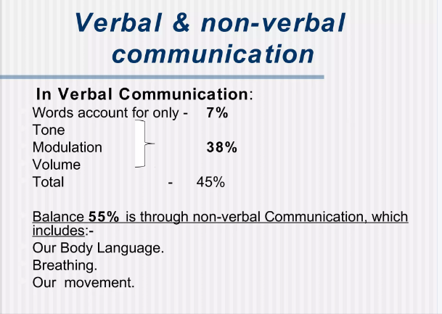

Slide 6
Verbal Communication
Definition: The use of words to convey thoughts, ideas, emotions, and information.
Methods: Includes spoken conversations, speeches, phone calls, sign language, and written messages such as emails and letters.
Characteristics:Allows for clear, direct communication of information.
Provides opportunities for immediate feedback.

Slide 7
Nonverbal Communication
Definition: The process of sending and receiving information without using words.
Methods: Encompasses a range of behaviors including:
Body Language: Gestures, posture, and movement.
Facial Expressions: Smiles, frowns, and other expressions of emotion.
Eye Contact: Directing one's gaze.
Paralanguage: Tone of voice, pace, volume, and pauses.
Appearance: Clothing and overall presentation.

Slide 8
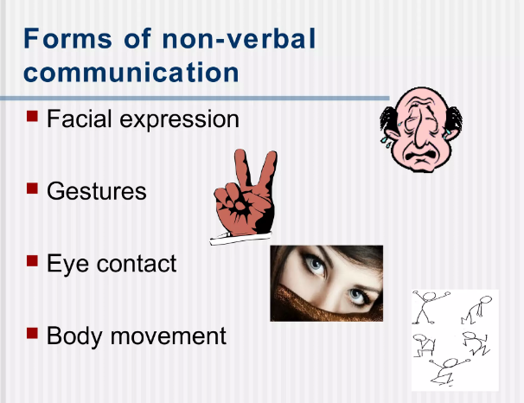

Slide 9
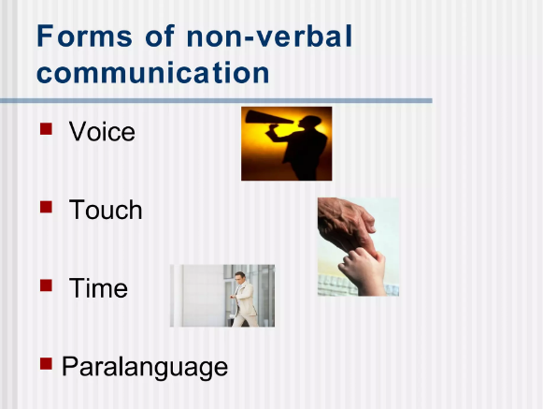

Slide 10
Characteristics:
Crucial for expressing emotions and building relationships.
Can reinforce, contradict, or substitute for verbal messages.

Slide 11
Relationship Between Verbal and Nonverbal Communication
Complementary: Nonverbal cues often enhance or clarify verbal messages.
Contradictory: A mismatch between what is said and how it is said (e.g., a smile while delivering bad news) can signal insincerity or conflict.
Integrated: Both forms are typically used simultaneously in interactions and are vital for achieving clear comprehension.

Slide 12
Verbal Communication
• Communication using words (spoken or written)
• Includes oral communication (speech, discussion) and written communication (letters, emails, reports)
• Examples: Speech, text messages, letters, reports

Slide 13
Nonverbal Communication
• Communication without words
• Uses body language, gestures, facial expressions, eye contact, posture, tone
• Examples: Nodding, smiling, frowning, hand gestures

Slide 14
Key Difference
• Verbal = words (oral + written)
• Oral = spoken words only
• Nonverbal = no words, only expressions & actions

Slide 15

Paralinguistics

Slide 16
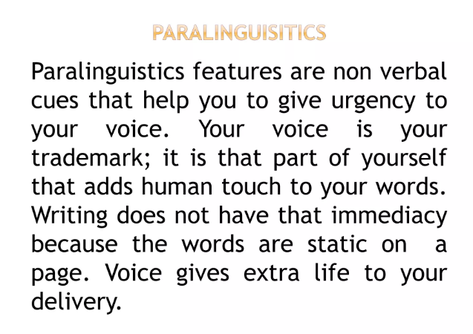

Slide 17
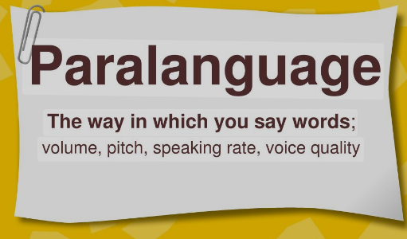

Slide 18
Paralinguistics refers to the non-verbal cues and features that are utilized consciously and unconsciously while communicating. These aspects of communication significantly impact meaning, and aid in better understanding the speaker's intention, emotion, and attitude.

Slide 19
Non-verbal cues
Give urgency to the voice
Voice gives extra life to the delivery
Language must be familiar to the audience

Slide 20
The Significance of Paralinguistics in Communication
Paralinguistics plays a major role in making communication more effective, expressive, and efficient. Its significance can be highlighted in the following aspects:
Conveying emotions: Paralinguistic cues such as facial expressions help express emotions that are challenging to communicate through words alone.
Enhancing understanding: Volume and speed of speech, intonation, and other vocal elements add depth and clarity to verbal communication, further supporting the conveyed message.
Contextualizing conversations: Paralinguistics helps shape the context of the interaction, enabling the listener to better comprehend the speaker's point of view and intentions.
Regulating conversation flow: Non-verbal behaviours such as gestures and bodily cues facilitate smooth conversation, helping maintain a congenial atmosphere between the speaker and the listener.

Slide 21
Components of Paralanguage:
Paralanguage includes vocal elements such as voice, tone, and pitch, which contribute to the overall impact and meaning of verbal communication. These components are described in more detail :

Slide 22

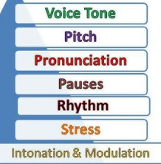

Slide 23
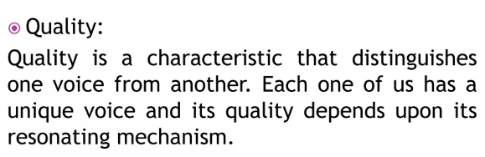
Quality of the voice
Everyone has a unique voice
Cannot be changed
Can be improved

Slide 24
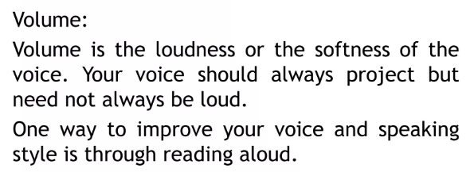
softness and loudness of the voice
not be too slow or too fast

Slide 25
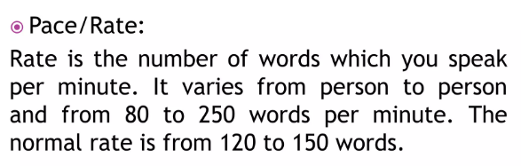
Number of words spoken per minute
Normal pace is from 120 to 150 words per minute
The speed of speaking not to be too slow or too fast

Slide 26
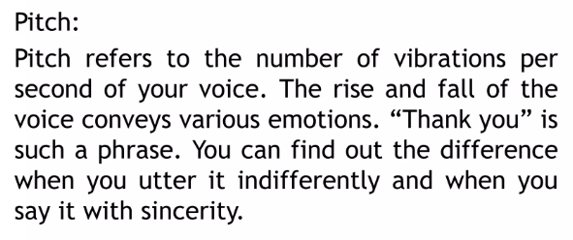
Rising and falling of voice
The number of vibrations per second
Conveys different emotions
Lowness of pitch can indicate sadness, dullness, guilt etc.
High pitch excited, joyous, triumphant, and angry,

Slide 27
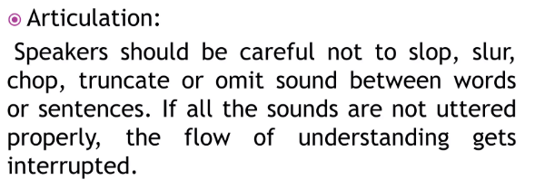
Means the art of speaking clearly
Do not slop, slur, chop, or omit sound
Flow of understanding gets interrupted
Negative impression
Lower the credibility of the speaker
Notes:
articulation means the art of speaking clearly. Speaker should be careful not to slop, slur, chop, or omit sound between words or sentences. If all the sounds are not uttered properly the flow of understanding gets interrupted and deters the listener from grasping the meaning of the message. The result is similar to the negative impression that written errors leave with a reader. Lazy articulation, slurred sounds, or skipping over words will lower the credibility of the speaker. Develop in yourself the ability to speak distinctly; produce the sounds in a crisp and lucid manner without causing any obfuscation

Slide 28
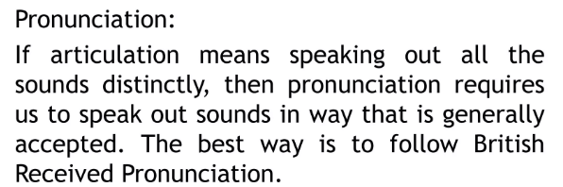
Speak out sounds in an accepted way
Follow British Received Pronunciation
Be careful enough pronunciation
Proper word stress
Notes:
pronunciation means to speak out sounds in a way that is generally accepted. The best way for English language is to follow British Received Pronunciation that is the standard of pronunciation. One should be careful enough pronunciation individual sounds along with word stress according to the set norms of R.P.

Slide 29
Voice modulation
Putting sentiments and emotions in the voice
Modulation Means intonation
Brings flexibility and vitality
Stress plays an important role
Notes:
voice modulation means intonation. It refers to the tonal variations, modulation pertains to the way we regulate, vary, or adjust the tone, pitch, and the volume of the sound or speaking of the voice. Modulation of the voice brings flexibility and vitality to ones voice, and one can express emotions, sentiment etc. if one does not pay special attention to the modulation of one’s voice, his voice becomes flat. Stress plays an important role in voice modulation.

Slide 30
Pauses
A short silence
Reflect on the message
Natural process to give a break
Helps to understand
Used at the right place

Slide 31
Haptics
Study of touch
Can create both positive and negative feelings
Notes:
Research has found that touching can create both positive and negative feelings. Your feelings are positive when the touch is perceived to be natural. A person gets the opposite feeling when the touch is perceived to be manipulative or insincere. Touch is experienced in many ways. Handshakes, pats, and kisses are just a few of the ways one can communicate by touching.
Manager Tip: A firm handshake says, "I care." A weak handshake says, "I care less."

Slide 32
Artifacts
Objects which express one’s interests, hobbies, status, or lifestyle
One’s wardrobe.
Jewellery, pictures, trinkets
key in establishing first impression
Notes:
Artifacts are often used to communicate information about oneself. Artifacts are objects, often clothes, jewelry, pictures, trinkets, which express one’s interests, hobbies, status, or lifestyle. Often noted in democratic societies, where all are thought to be equal, artifacts are used to announce inequalities that for reasons of taste and conformity, cannot be expressed in words.
One of the most influential artifacts a person possesses is one’s wardrobe. Much psychology and communication research supports that -at least in the observer’s eyes- that clothes do make the man (or woman!). Lefkowitz, Blake, and Mouton found in their own study that dress can even affect how willing others will be to follow you. This study found that significantly more individuals would follow a model’s example in crossing against the "wait" signal when dressed in a business suit than when the same model crossed the street dressed in poor work clothes.
Manager Tip: Artifacts are key in establishing first impressions. If you are looking to improve your own professional style, make note of what artifacts gives strangers a professional look.

